Slide 1
Penyelesaian LUN 2014
Paket E

Slide 2
1. 3⁻¹ + 7⁻¹
= +
= +
=

Slide 3
2.
=
=
=
=
=

Slide 4
3. 35 – 21 : 7
= 35 – 3
= 32

Slide 5
4.Keliling 56
56 = 2 (4y + 3y)
56 = 2 (7y)
56 = 14y
4 = y
Panjang = 4y = 4 . 4 = 16 cm
Lebar = 3y = 3 . 4 = 12 cm
Luas = 16 X 12 = 192 cm²

Slide 6
5. Menabung 4.500.000,- 8% 5bl
2
15
Bunga 7 bl = X X 4.500.000
3
= 150.000
Jumlah uang = 4.500.000 + 150.000
= 4.650.000,-

Slide 7
6. 1, 7, 3, 12, 5, 17, …
Diubah jadi dua barisan
1, 3, 5, 7, 9
7, 12, 17, 22, 27
Jadi suku selanjutnya 7 dan 21

Slide 8
7. 44, 48, 52. … , 96.
96 = 44 + 4(n – 1)
96 = 44 + 4n – 4
96 – 44 + 4 = 4n
56 = 4n
14 = n

Slide 9
8. U₅ = a + 4b = 19
U₁₄ = a + 13b = 46
–
-9b = -27
b = 3
a + 4.3 = 19
a = 19 – 12 = 7
S₂₀ =
= 710

Slide 10
9.
9 + 3 = 5x – 2x
12 = 3x
4 = x
X + 5 = 4 + 5 = 9

Slide 11
10. i.

Slide 12
11.
(miring ke kiri)
Y
2
k
O
X
4

Slide 13
12.
3y = -2x + 10

Slide 14
13. K = 2 ( p + l )
80 = 2(2x + 5 + x + 5)
40 = (2x + x + 5 + 5)
40 = 3x + 10
40 – 10 = 3x
30 = 3x
10 = x
Panjang = 2 (10) + 5 = 20 + 5 = 25 cm
Lebar = 10 + 5 = 15 cm

Slide 15
14. Dari 36 orang, 21 orang diantaranya gemar sepak bola dan 18 orang gemar basket, sedangkan 5 orang tidak gemar sepak bola maupun basket. Banyak siswa yang gemar basket saja adalah ....
B
K
21-x
18 - x
x
5
Suka kedua= 21+18+5-36 =
8
Basket saja= 18 – 8 =
10

Slide 16
15. f(x)=4x – 3

Slide 17
16. 4t + 3b = 83
3t + 4b = 85
| X3 |
| X4 |

Slide 18
17.
D
26
C
CD² = 26² – 24² – 6²
6
A
24
B
= 676 – 576 – 36
= 64
CD = 8

Slide 19
18.
C
ΔAGF ≅
ΔBGF
ΔAGE ≅
ΔBGD
ΔEGC ≅
ΔDGC
E
D
G
ΔABD ≅
ΔBAE
A
B
ΔADC ≅
ΔBEC
F
ΔAFC ≅
ΔBFC
ΔAGC ≅
ΔBGC

Slide 20
19.
B
D
21
A
9
15
15
E
C
D
C
15
9
E
A
B
A
15
x
9x = 15 (15)

Slide 21
20.
D
x
C
3
E
F
x
12
12-x
4
x
B
A
16
16-x
3(16 – x) = 7(12 – x )
48 – 3x = 84 – 7x
7x – 3x = 84 – 48
4x = 36
x = 9

Slide 22
21.
D
6 cm
C
10 cm
A
B
ABCD dibagi menjadi 4 sama besar
Luas arsiran = 6 X 6 : 4
= 9 cm²

Slide 23
22.
5
5
20 : 4 =
5
10
15
5
10
10
20
Keliling = 20+15+5+10+10+5+5+10
= 80 cm

Slide 24
23
23.
2
1
3
4
Jadi urutannya: 1, 4, 3, 2

Slide 25
24.
Besar sudut = 90 - 60
Besar sudut = 30
Pelurus = 180 – 30 = 150

Slide 26
25.
2
5
= 12 X 3,14
= 75,36

Slide 27
26.

Slide 28
27.
bukan
ya
ya
bukan

Slide 29
28. Kerangka = 4X(alas +tegak)
=4 X ( 10 + 15)
=1 m
Banyak kerangka = 4,6 : 1
= 4 sisa 0,6 m

Slide 30
29.
Sisi prisma = n + 2
Sisi prisma = 6 + 2
Sisi prisma = 8
Rusuk prisma = 3n
Rusuk prisma = 3(6)
Rusuk prisma = 18

Slide 31
30.
Volume prisma = Luas alas X tinggi
= 2.880 cm²

Slide 32
31. V
4

Slide 33
32.
24
26
10
20
L =20² +1/2 X 4 X 20 X 26
L =400 +2X 520
L =400 + 1040
L = 1440

Slide 34
34. L.sisi

Slide 35
34.

Slide 36
35.
24 X 79 -
4 X 74
Rata-rata =
24 – 4

Slide 37
36.
Tinggi | 145 | 146 | 147 | 148 | 150 | 152 | 155 | 157
Frek | 4 | 4 | 6 | 7 | 8 | 5 | 4 | 2
Kum
4
8
14
21
Md= data ke-
Md= data ke- 20,5
Md= 148

Slide 38
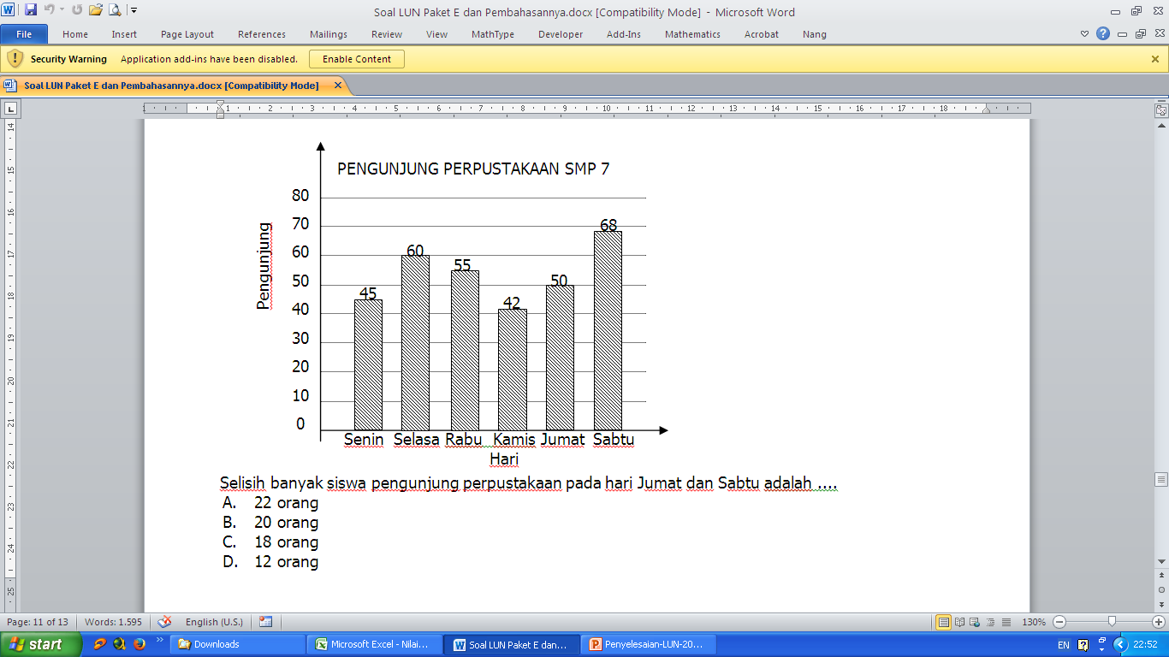
37.
Selisih Jumat dan sabtu = 68 – 50
= 18

Slide 39
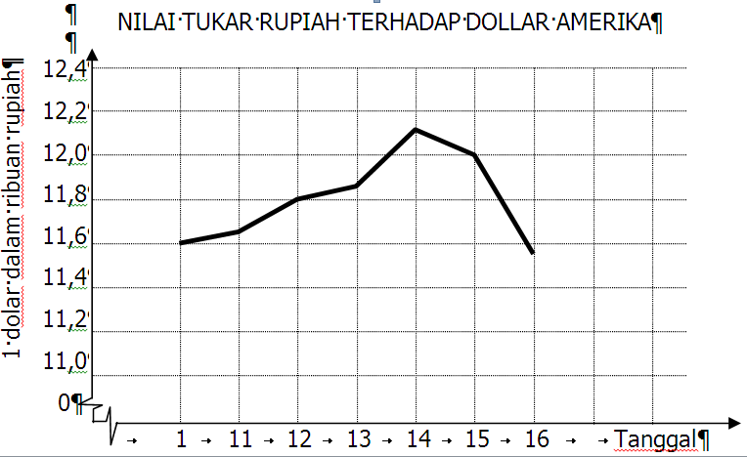
38.
Nilai tukar tgl 11 = 11.650

Slide 40
39. Ruang Sampel:
A1, A2, A3, A4, A5, A6
G1, G2, G3, G4, G5, G6

Slide 41
40. Sudut merah =
= 360 – (54 + 36 + 27 + 90 + 36 + 72)
= 360 – 315
= 45
1
8
54
36
72
27
90
36

