Slide 1
Penyelesaian LUN 2014
Paket A

Slide 2
1. 2⁻¹ + 5⁻¹
= +
= +
=

Slide 3
2.
=
=
=
=
=

Slide 4
3. 27 – 18 : 3
= 27 – 6
= 21
= 16

Slide 5
4.Keliling 42
42 = 2 (4y + 3y)
42 = 2 (7y)
42 = 14y
3 = y
Panjang = 4y = 4 . 3 = 12 cm
Lebar = 3y = 3 . 3 = 9 cm
Luas = 12 X 9 = 108 cm²

Slide 6
5. Menabung 3.000.000,- 8% 7bl
2
Bunga 7 bl = X X 3.000.000
3
= 14.000
Jumlah uang = 3.000.000 + 140.000
= 3.140.000,-

Slide 7
6. 1, 6, 3, 11, 5, 16, …
Diubah jadi dua barisan
1, 3, 5, 7, 9
6, 11, 16, 21 26
Jadi suku selanjutnya 7 dan 21

Slide 8
7. 42, 45, 48. … , 99.
99 = 42 + 3(n – 1)
99 = 42 + 3n – 3
99 – 42 + 3 = 3n
60 = 3n
20 = n

Slide 9
8. U₅ = a + 4b = 19
U₁₂ = a + 11b = 47
–
-7b = -28
b = 4
a + 4.4 = 19
a = 19 – 16 = 3
S₂₀ =
= 820

Slide 10
9.
5 + 3 = 5x – 3x
8 = 2x
4 = x
X + 5 = 4 + 5 = 9

Slide 11
10. i.

Slide 12
11.
(miring ke kiri)
Y
3
k
O
X
5

Slide 13
12.
2y = -3x + 6

Slide 14
13. K = 2 ( p + l )
82 = 2(2x + 3 + x + 5)
41 = (2x + x + 3 + 5)
41 = 3x + 8
41 – 8 = 3x
33 = 3x
11 = x
Panjang = 2 . 11 + 3 = 22 + 3 = 25 cm
Lebar = 11 + 5 = 16 cm

Slide 15
14. Dari 44 orang. 29 orang di antaranya gemar sepak bola dan 26 orang gemar basket, sedangkan 4 orang tidak gemar sepak bola maupun basket. Gemar sepak bola saja = …
B
K
29-x
26 - x
x
4
Suka kedua= 29+26+4-44 =
15
Sepak bola saja= 29 – 15 =
14

Slide 16
15. f(x)=3x – 2

Slide 17
16. 3t + 5b = 108
2t + 3b = 67
| X2 |
| X3 |

Slide 18
17.
A
17
12
D
AD² = 12² + 9² + 8²
= 144 + 81 + 64
8
B
C
9
= 289
AD = 17

Slide 19
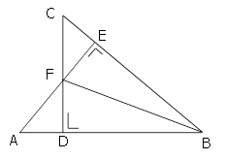
18.
ΔABF ≅
ΔCBF
ΔADF ≅
ΔCEF
ΔBDF ≅
ΔEBF
ΔABE ≅
ΔCDB

Slide 20
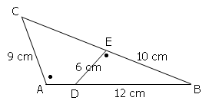
19.
C
D
9
6
A
B
E
B
x
10
6x = 9 (10)
x = 15

Slide 21
20.
D
5
C
1
E
F
5
10
5
2
B
A
x
X = 15
AB = 5 + 15 = 20 cm

Slide 22
21.
D
12 cm
C
15 cm
A
B
ABCD dibagi menjadi 4 sama besar
Luas arsiran = 12 X 12 : 4
= 48 cm²

Slide 23
22.
5
5
20 : 4 =
5
10
15
5
5
5
5
5
20
Keliling = 10 + 15 + 20 + 5 x 7
= 80 cm

Slide 24
23
23.
2
1
3
4
Jadi urutannya: 1, 3, 4, 2

Slide 25
24.
Besar sudut = 180 - 120
Besar sudut = 60
Penyiku = 90 – 60 = 30

Slide 26
25.
2
5
= 8 X 3,14
= 25,12

Slide 27
26.

Slide 28
27.
ya
bukan
ya
bukan

Slide 29
28. Kerangka = 4X(alas +tegak)
=4 X ( 10 + 20)
=1,2 m
Banyak kerangka = 5,9 : 1,2
= 4 sisa 1,1 m

Slide 30
29.
Sisi prisma = n + 2
Sisi prisma = 7 + 2
Sisi prisma = 9
Rusuk prisma = 3n
Rusuk prisma = 3(7)
Rusuk prisma = 21

Slide 31
30.
Volume prisma = Luas alas X tinggi
= 2.880 cm²

Slide 32
31. V
2

Slide 33
32.
12
13
5
10
L =10² +1/2 X 4 X 10 X 13
L =100 +2X 130
L =100 + 260
L = 360

Slide 34
34. L.sisi

Slide 35
34.

Slide 36
35.
20 X 78 -
4 X 74
Rata-rata =
16

Slide 37
36.
Tinggi | 145 | 146 | 147 | 148 | 150 | 152 | 155 | 157
Frek | 3 | 4 | 6 | 7 | 8 | 5 | 4 | 3
Kum
3
7
13
20
Md= data ke-
Md= data ke- 20,5
Md= 149

Slide 38
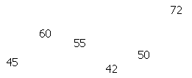
37.
Jumlah 3 hari terakhir = 72 +50 + 42
Jumlah 3 hari terakhir = 164

Slide 39
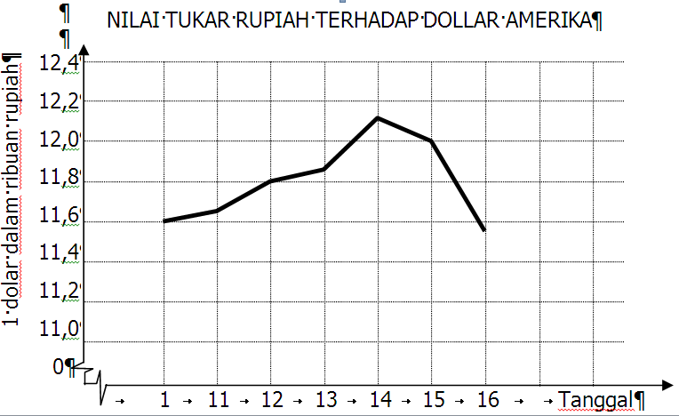
38.
Nilai tukar tgl 12 = 11.800

Slide 40
39. Ruang Sampel:
A1, A2, A3, A4, A5, A6
G1, G2, G3, G4, G5, G6

Slide 41
40. Sudut merah =
= 360 – (18 + 36 + 108 + 36 + 18 + 90)
= 360 – 306
= 54
3
20

